Slide 1



TRANSFERMARKT DATA LAKE
From Raw Data to Football Intelligence using a Scalable Medallion Architecture on AWS

Slide 2






Business Use Cases
Scouting & Recruitment
Historical Analysis
Performance Analytics
Implementing a "Moneyball" approach to identify undervalued players through rigorous performance metrics and market value analysis.
Analyzing the evolution of game tactics, goal trends, and attendance figures over decades to spot long-term patterns.
Comparative analysis of home/away performance, squad composition, and high-stakes derby match outcomes.

Slide 3

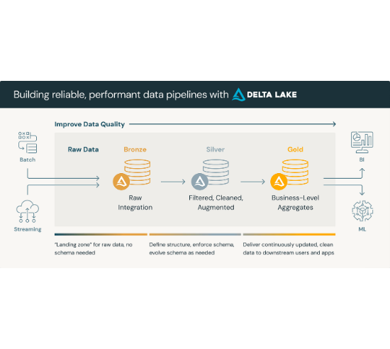
Medallion Architecture
🥉 Bronze (Raw Ingestion): Direct dump of CSVs converted to Parquet (Columnar storage) for query efficiency. No schema changes.
🥈 Silver (Cleansed): Data type casting, null handling, deduplication, and standardization logic applied.
🥇 Gold (Business Level): Aggregated data modeled into a Star Schema (Facts & Dimensions) ready for high-speed reporting.

Slide 4
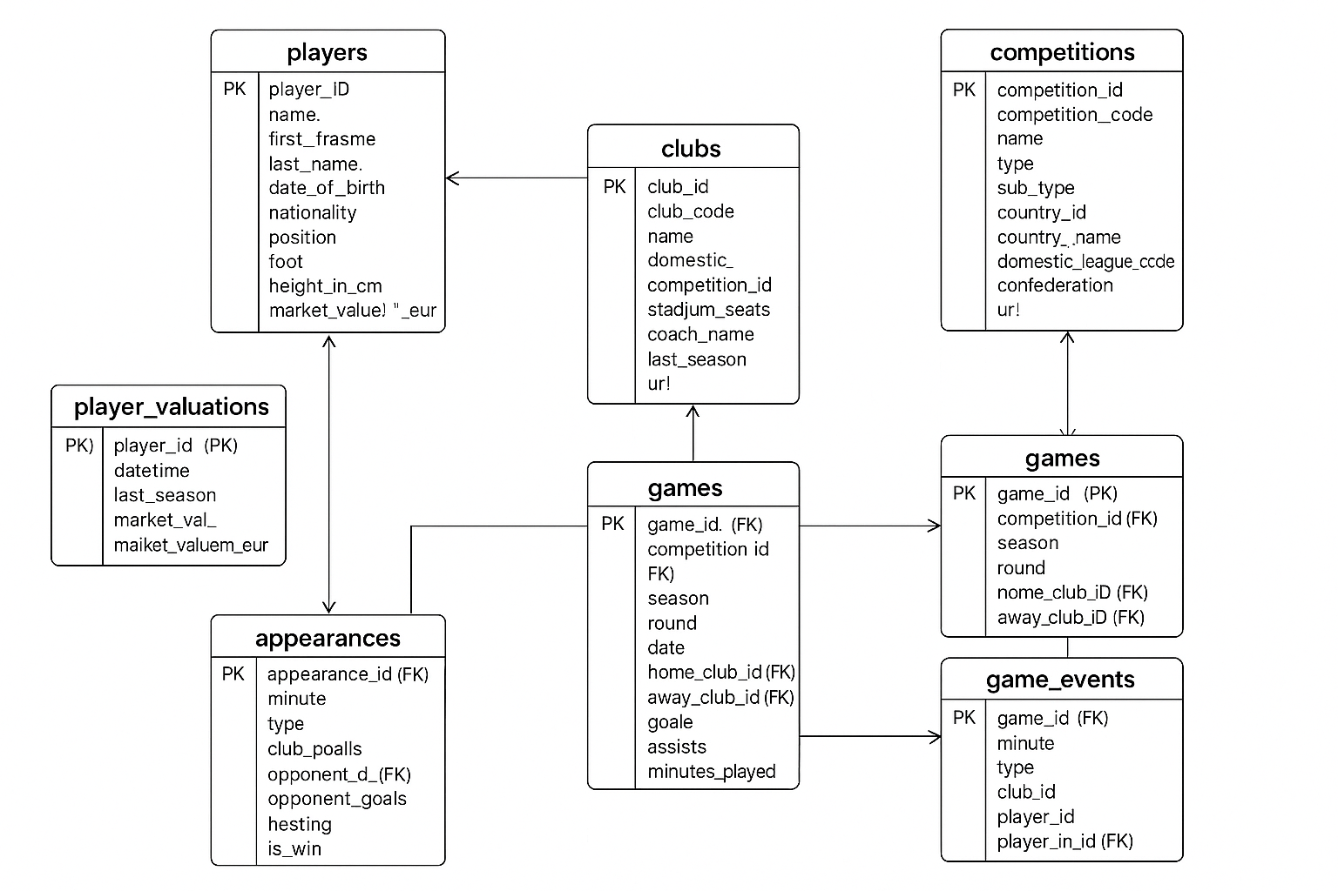
The Dataset: Football Analysis
Source: Comprehensive relational database from Football datasets.
Structure: 8 interconnected datasets covering all aspects of professional football.
Key Tables:
Players (Demographics, Market Value)
Games (Scores, Dates, Attendance)
Appearances (Match stats)
Game Events (Cards, Subs)
Volume: Thousands of matches, players, and historical seasons.

Slide 5

Data Cleansing
Objective
Cleaned data to ensure correct reports and reliable analysis
Actions
✔ Fixed missing values and nulls
✔ Removed duplicate records
✔ Standardized dates, numbers, and names
✔ Added calculated fields like full name and age
✔ Checked links between players, clubs, competitions
Outcomes
✔ Clean, consistent data stored in Silver Layer
✔ Ready for Galaxy Schema modeling and Gold Layer reports
✔ Supports 10+ business insights (Top Scorers, Season Trends, Player Performance)

Slide 6
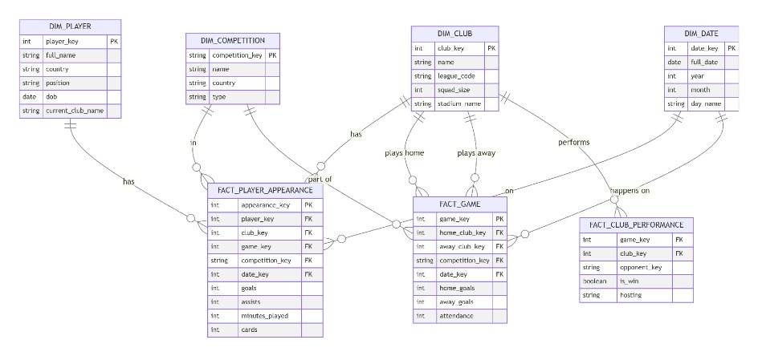
Dimensional Modeling
Designed a Galaxy Schema for faster OLAP reporting and better analysis :
Dimension Tables:
DIM_PLAYER, DIM_COMPETITION, DIM_CLUB, DIM_DATE
Fact Tables:
FACT_PLAYER_APPEARANCE (Stats), FACT_GAME (Results) and FACT_CLUB_PERFORMANCE.
Outcome: 10+ Pre-calculated business reports ready for visualization (e.g., Top Scorers, Season Trends, etc..).

Slide 7
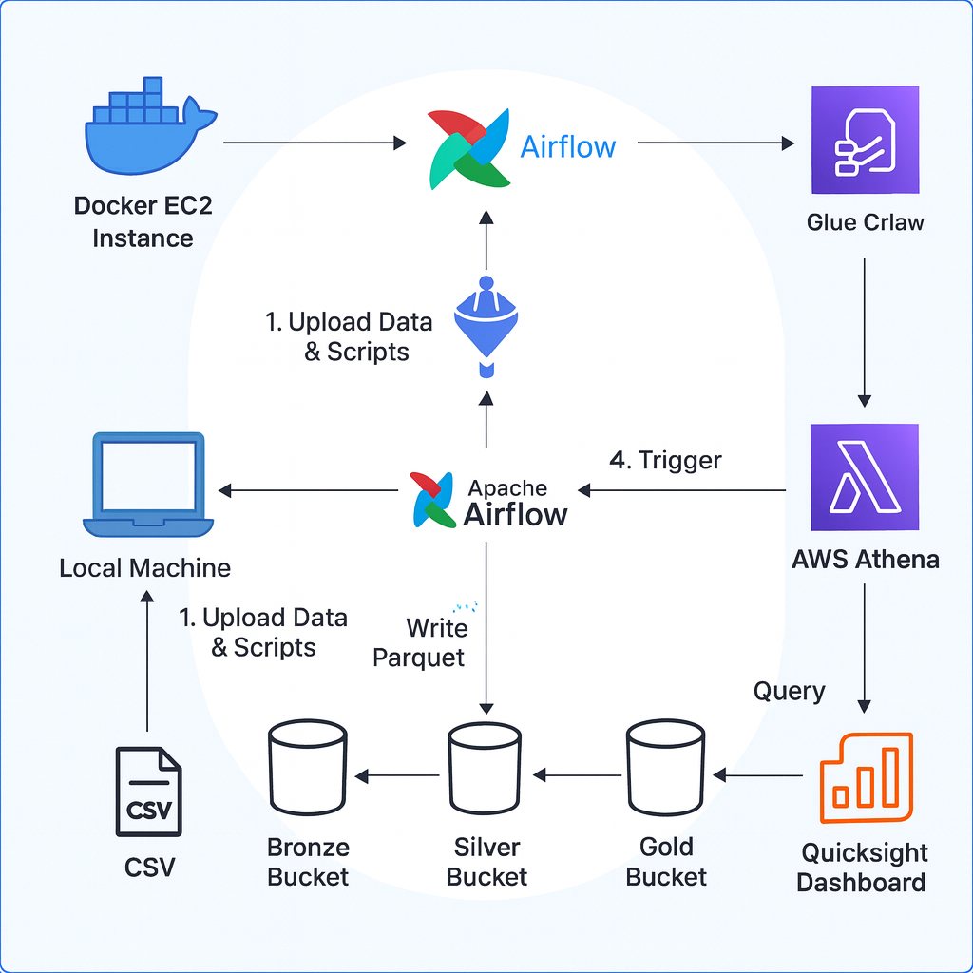
Infrastructure on AWS
Storage (Data Lake)
Amazon S3: Segregated buckets for raw, bronze, silver, and gold layers.
Compute (Serverless ETL)
AWS Glue: Serverless Spark environment for heavy transformations.
Orchestration
Amazon EC2: Hosting Dockerized Airflow for pipeline management.
Querying
Athena: SQL access to S3 files.

Slide 8




Pipeline Orchestration
Ingestion
Raw → Bronze
Bronze → Silver
Silver → Gold
Bucket checks & Upload raw data to S3
Format conversion to Parquet
Cleaning, De-duping & Logic
Star Schema & Crawler Update

Slide 9
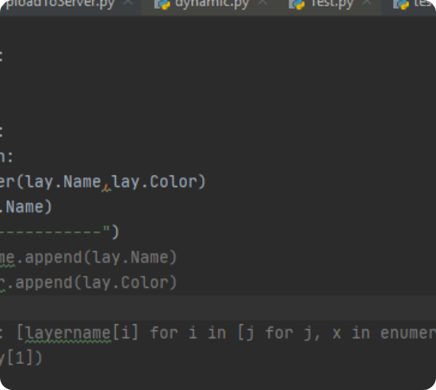
Engineering Challenges
Schema Evolution: Automatically handling data drift between different seasons of data.
Ambiguity Handling: Implemented smart_join logic to resolve duplicate column names during complex multi-table joins (e.g., Games + Appearances).
Data Quality: rigorous null handling for string columns and standardization of date formats across datasets.

Slide 10
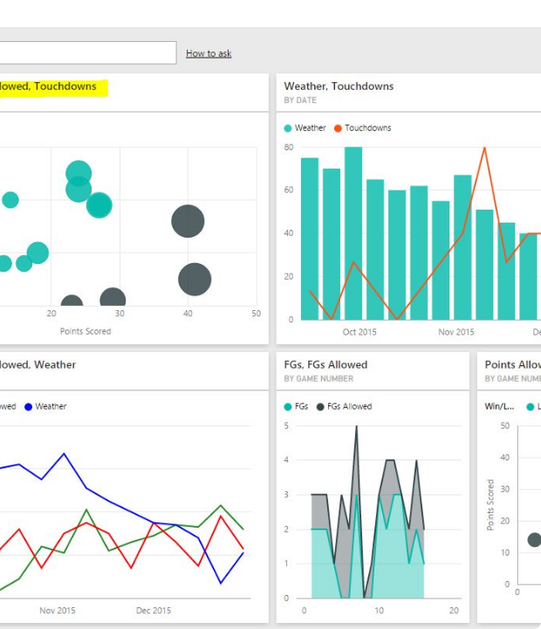
Visualization & Insights
Tools: QuickSight & Athena
Leveraging Amazon QuickSight for interactive dashboards and Athena for ad-hoc SQL analysis.
Key Dashboards
Global Overview: Goal trends & Heatmaps
Discipline: "Bad Boys" Tree Map & Red Cards

Slide 11




Summary & Future Scope
Key Achievements
Future Enhancements
Fully automated, "one-click" deployable pipeline.
Streaming: Ingest live match data using Kinesis.
Scalable serverless architecture (Zero maintenance).
Machine Learning: Predict match outcomes using historical data.
Cost-effective (Glue runs only on demand).
CI/CD: Integrate GitHub Actions for deployment.

Slide 12
Q&A
Thank you!

